Slide 1
Electric Vehicle Sales Dashboard – India
Prepared by: Admane Sushil
Tool: Microsoft Power BI

Slide 2
Objective :
To analyze electric vehicle (EV) sales trends across India
To identify top-performing states and vehicle segments
To understand EV adoption growth over time
To present insights through an interactive Power BI dashboard

Slide 3
Dataset Description :
Year
Month Name
Date
State
Vehicle Class
Vehicle Category
Vehicle Type
EV Sales Quantity

Slide 4
Data Cleaning & Modeling:
Removed missing and invalid records
Created a Calendar (Date) table
Established relationships between Date & Fact tables
Sorted months using Month Number
Ensured correct data types

Slide 5
Key Performance Indicators
Total EV Sales
Year-over-Year (YoY) Growth %
Top Performing State
Total States Covered
Total Vehicle Types

Slide 6
Dashboard Components
KPI Cards
Monthly Trend Line Chart
State-wise Sales Map
Top 10 States Bar Chart
Vehicle Class & Category Analysis
Interactive slicers (Year, Month, Vehicle Type)

Slide 7
EV Sales Trend Analysis
Monthly sales trends highlight growth pattern
Consistent increase in EV adoption over time
YoY Growth % shows market expansion

Slide 8
Geographical Insights
Map visual highlights EV adoption across states
Top 10 states identified based on sales
Regional demand patterns clearly visible

Slide 9
Vehicle Class & Category Analysis
EV sales broken down by:
  2-Wheelers
  3-Wheelers
  4-Wheelers
  Commercial EVs
Donut & bar charts show contribution share

Slide 10
Technologies Applied
Microsoft Power BI
DAX
Data Modeling
Data Cleaning
Data Visualization & Storytelling

Slide 11
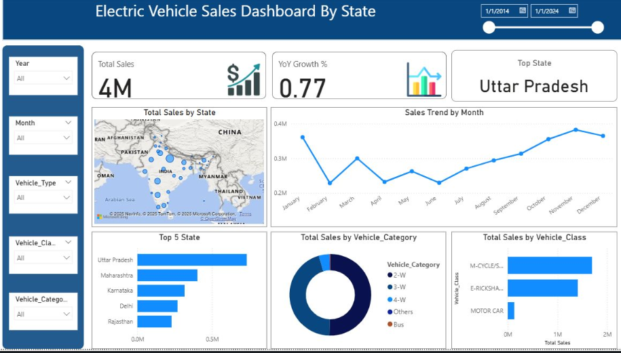
Dashboard:

Slide 12
Project Summary
Built an end-to-end EV sales analytics dashboard
Converted raw data into actionable insights
Designed a professional, interactive dashboard
Demonstrates strong BI and analytical skills

